Slide 1
EENG 385 Schmitt Trigger Oscillator
Notes:
Usually the <title of the lab> is what will be called the “System” through the rest of this document

Slide 2
Lab Objectives
Introduce the theory, simulation and construction of a circuit that uses positive feedback to form an oscillator.

Slide 3
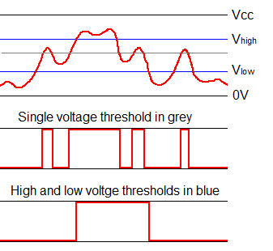
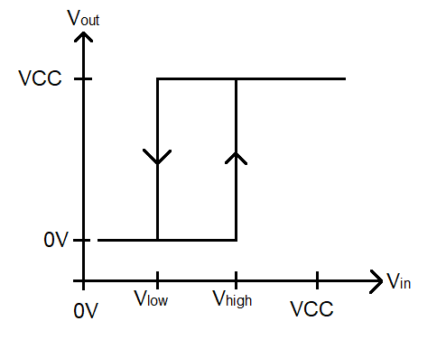
Theory
Good for noise rejection
Analog signal (top) converted with a single threshold (middle) then Schmitt trigger (bottom).
Notes:
Replace <System> with the name of the

Slide 4
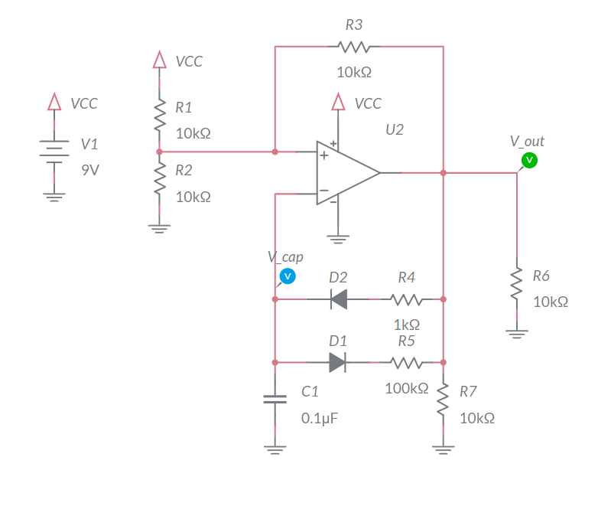
Theory
VCC = 9V
Assume Vout = 9V
C1 charges through R4
V- increase
Causing Vout = 0V
Assume Vout = 0V
C1 discharges through R5
V- decreases
Causing Vout = 9V
Notes:
Replace <System> with the name of the

Slide 5
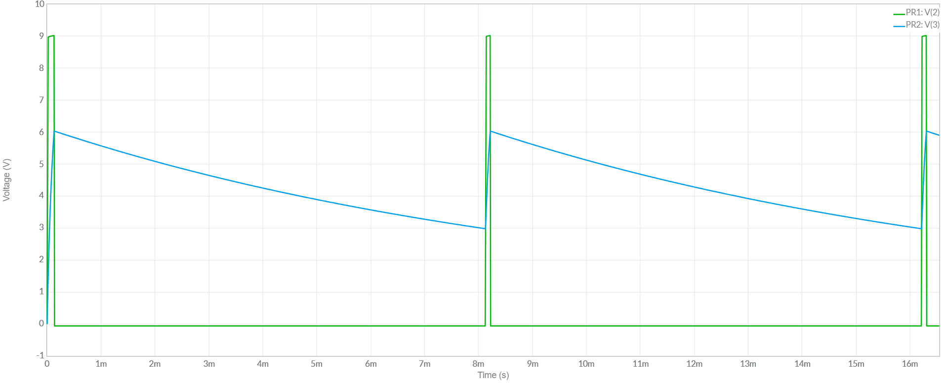
Simulate
Use LTSpice
Probe op amp output and capacitor voltage
Notes:
Replace <System> with the name of the

Slide 6
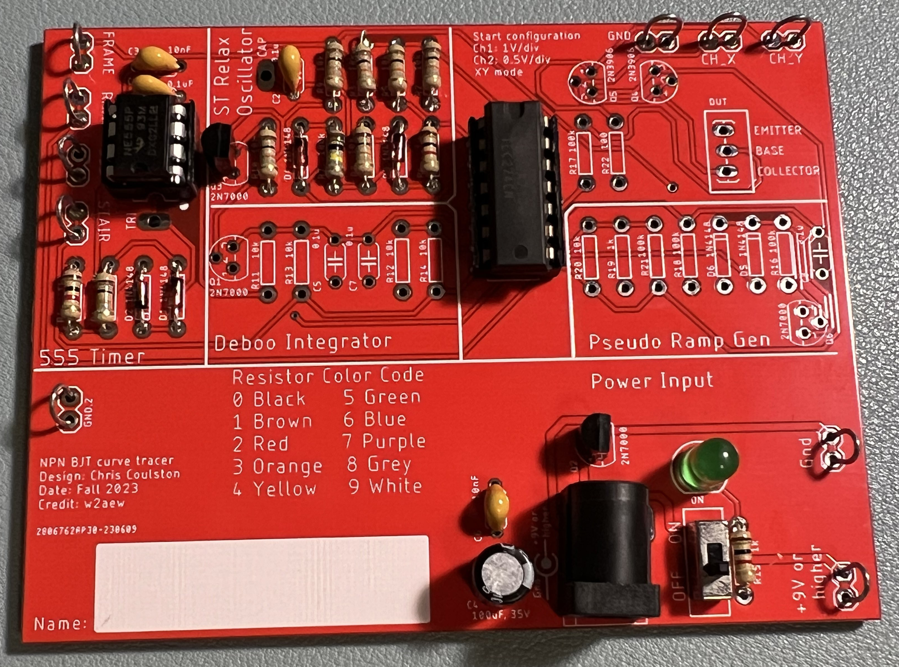
Assemble
Use 14-pin socket for TLC274
Parts are in Brown 305
Just assemble ST Relax
Notes:
Replace <System> with the name of the

Slide 7
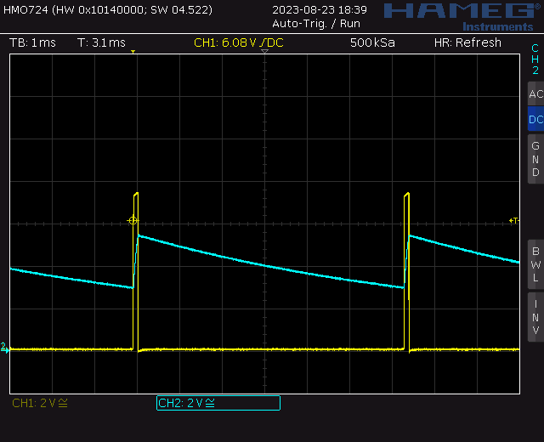
Test
Probe op amp output and capacitor voltage
Should be within 25% of simulation values
Notes:
Replace <System> with the name of the

Slide 8
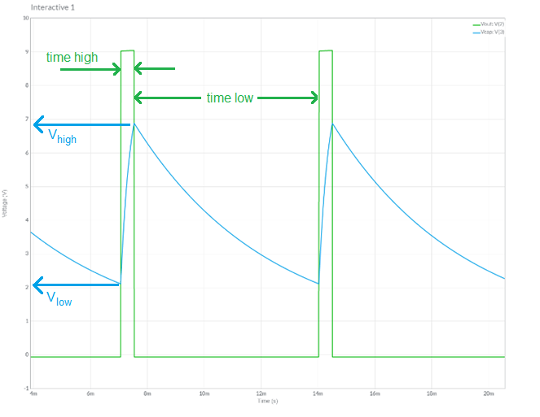
Turn In
Summary of analysis, simulation and assemble
Table 4 op amp output
Table 5 capacitor C1
Answer listed questions
Save solutions as PDF
Due before start of class next week
Every student builds their own board
Everyone brings their board to class

